Slide 1
Adapting the Home for Wheeled Mobility
Frazier Rehab Institute
Spinal Cord Medicine Program

Slide 2
What does being at home mean to you?
Each of us has ideas of what we need in a home…
Security and safety
Privacy
Convenience
A place to heal
A place to eat, sleep, bathe, come and go, and do usual daily tasks as easily as possible
Feel comfortable and able to relax with others
Able to communicate and be understood & accepted

Slide 3
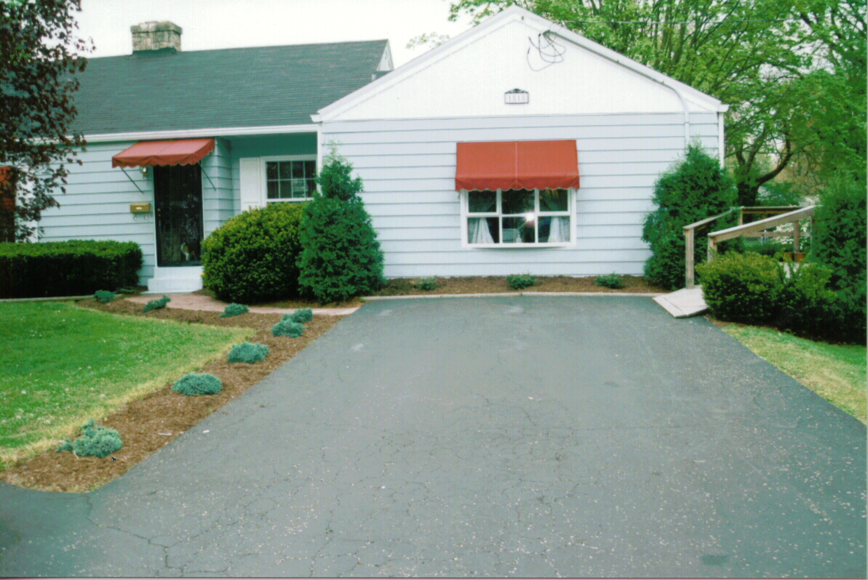
Adapting the Home
It’s time to start talking about it
What do you need to know
What are your resources?
How do you get started?

Slide 4
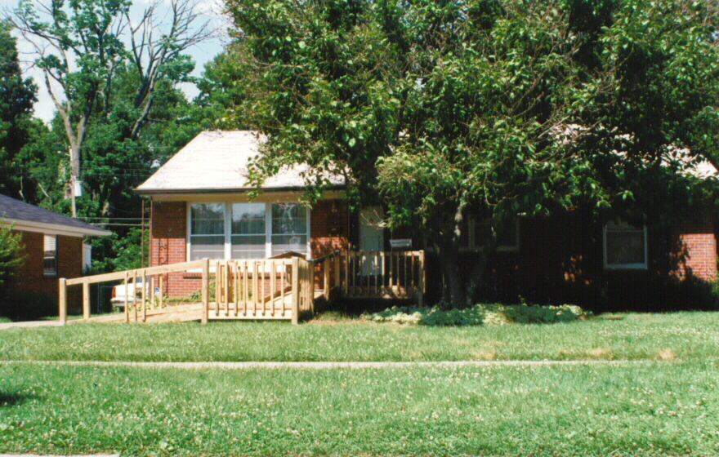
Adapting the Home
See examples of:
Ramps
Bathrooms
Living Area
Kitchens
Outdoor Living
Let’s start with Ramps

Slide 5
Getting in/out of the house with a wheelchair
The American with Disabilities Act (ADA) encourages use of a 1:12 ramp… commonly seen in public spaces
1:12 means: to climb 1”, use 12” of ramp
A 1:12 is safer for walkers and is within the ability of a manual wheelchair rider or someone pushing a wheelchair
To ramp a rise of 5”, use 5’/feet of ramp for a 1:12 ramp
To ramp a rise of 14”, use 14‘/feet of ramp for a ramp
A good resource:
http://www.wikihow.com/Build-a-Wheelchair-Ramp

Slide 6
Getting in/out of the house with a wheelchair
Building a Ramp requires that you:
Pre-plan: Where is the best place? Do you need a building permit? How much will it cost? How much material? Plan for a 1:12 grade!
A ramp should include these features:
36” of width to accommodate the wheelchair/person
Handrails, vertical uprights and a curb stop to keep all 4 wheelchair wheels on the ramp
Start a ramp at a sidewalk or pavement and end it with a level landing at the building entry
Create a non-slip surface: use shingles, adhesive strips, etc.
Create a level spot for resting when you build a long ramp

Slide 7
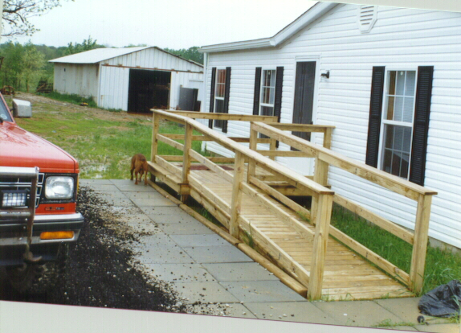
Well-designed Ramps

Slide 8
Well-designed Ramps

Slide 9
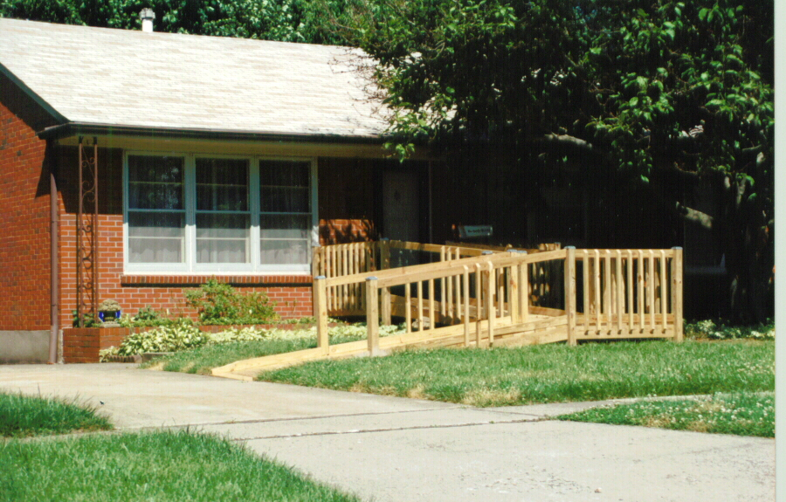
Well-designed Ramps

Slide 10
Well-designed Ramps
House
Ramp Landing
5’
Ramp
36”
5’

Slide 11
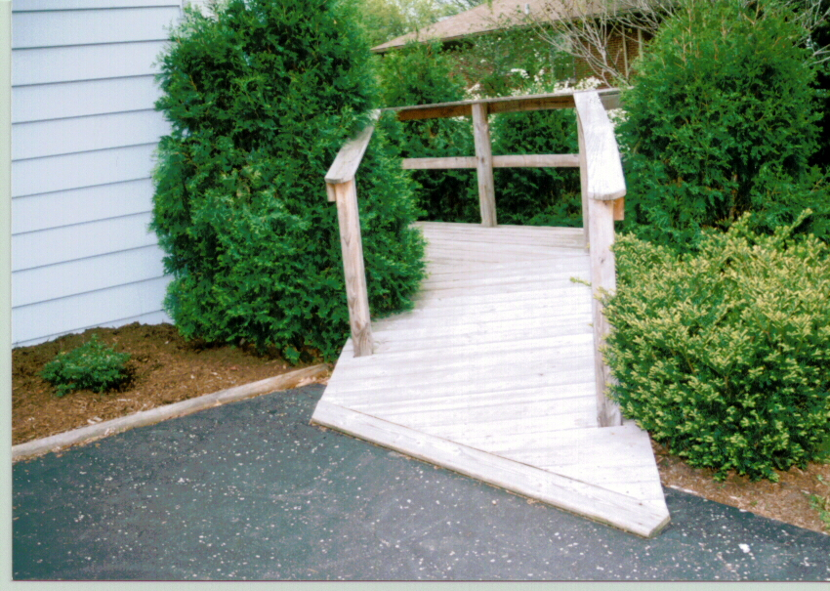
Well-designed Ramps
In this remodel, a 2-car garage was made into a wheelchair accessible apartment for someone with C-3,4 SCI injury. The ramp runs along the side of the house to the back and entry through the laundry/mud room. The ramp is hardly noticeable.

Slide 12
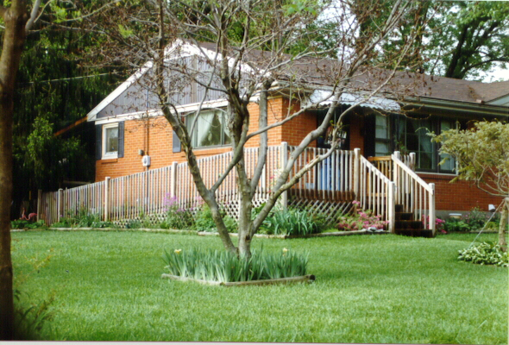
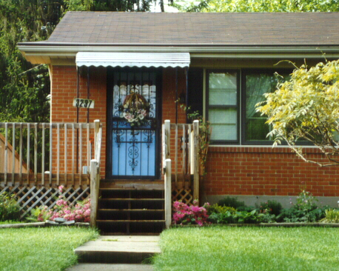
Well-designed Ramps
A way to hide the extra ramp length needed to climb more than 5 steps at the front entry
From the front door, this ramp slopes down to the alley way and the garage where transfers occur!

Slide 13
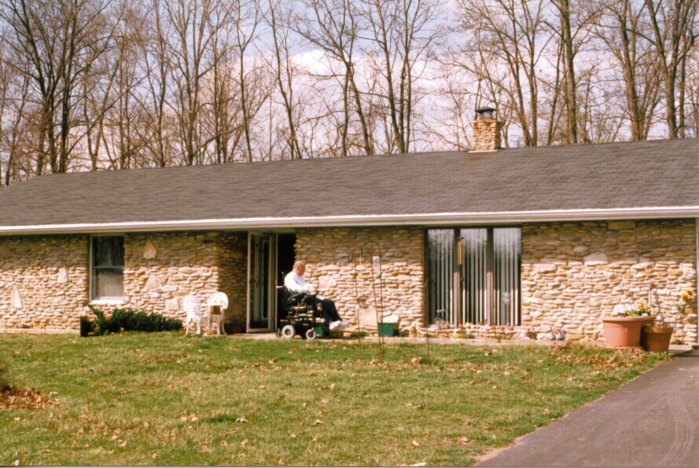
Some houses don’t need a ramp!

Slide 14
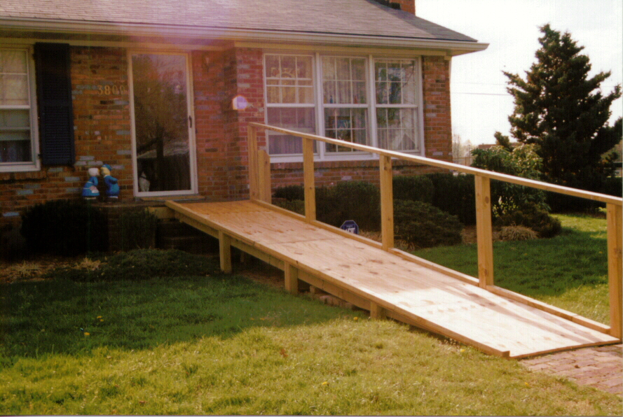
Would you have done something different?

Slide 15
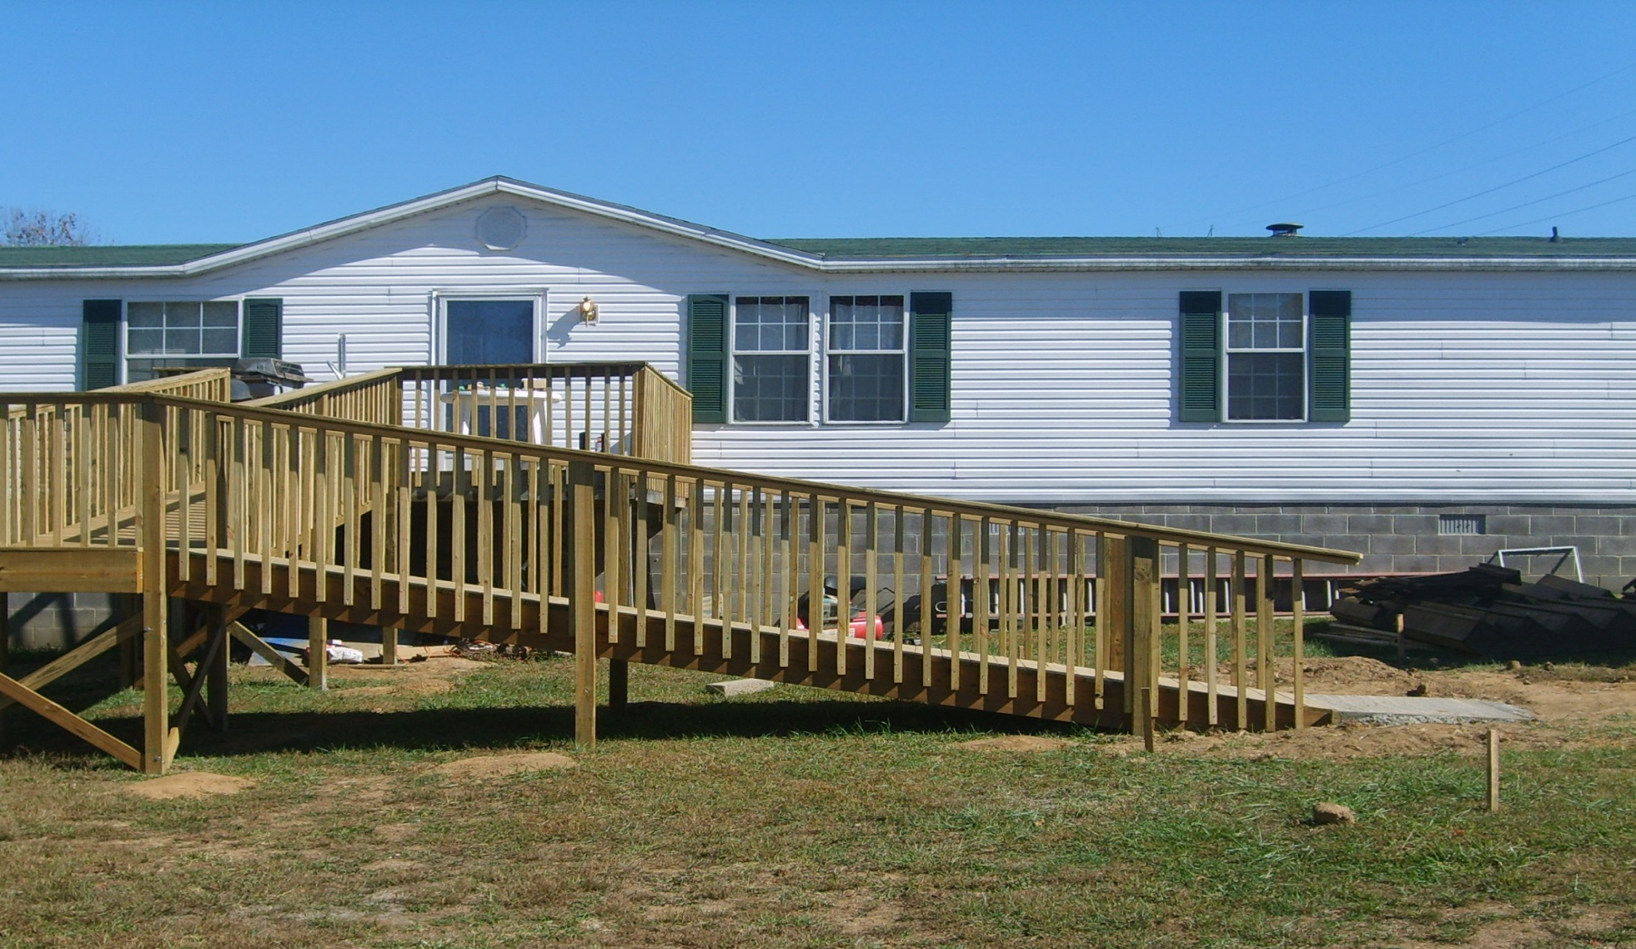
Would you have done something different?

Slide 16
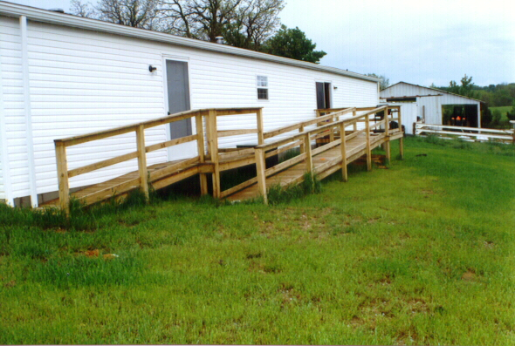
Would you have done something different?

Slide 17
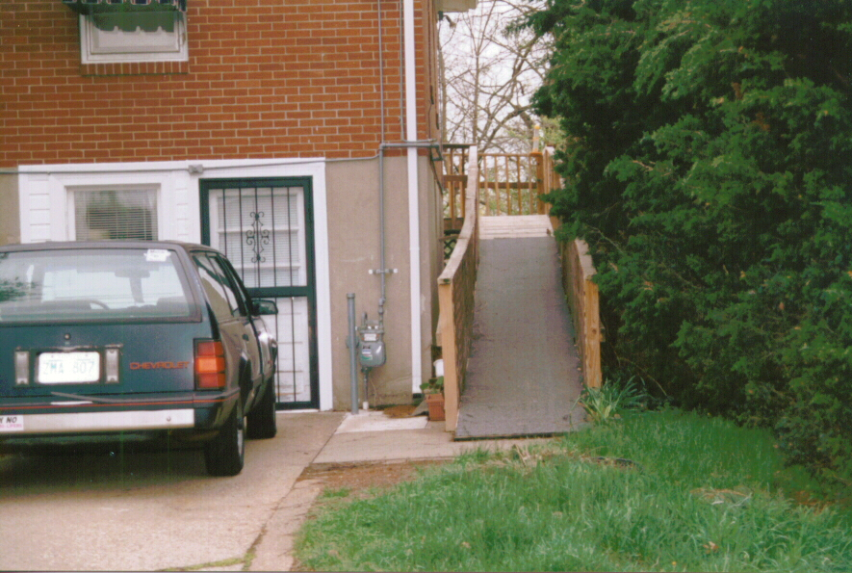
Would you have done something different?

Slide 18
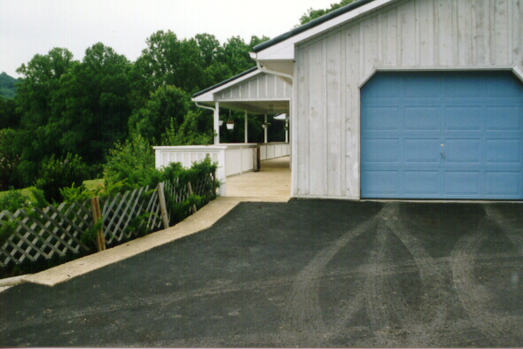
Things to consider
Disguise or hide your ramp and keep it dry and snow free
Tuck it into a two-car garage with a ramp or a porch lift
Enter through the laundry, mud room or kitchen

Slide 19
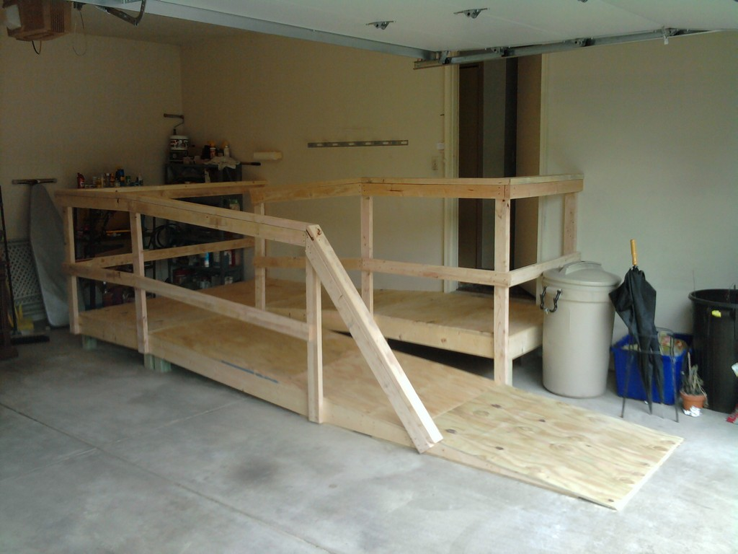
Garage Ramp
Garage Ramp with a switch back. It takes up one car space
Enter the garage with a garage door opener.

Slide 20
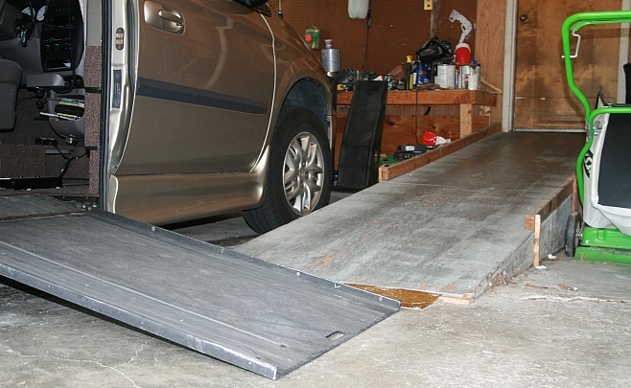
Garage Ramp

Slide 21
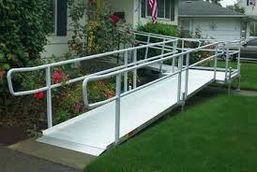
Rent a ramp for temporary use

Slide 22
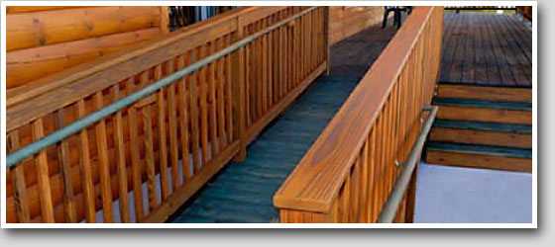
Things to consider
Two sets of hand rails - one at normal height, the other at wheelchair height
Maintain steps along with ramp!

Slide 23
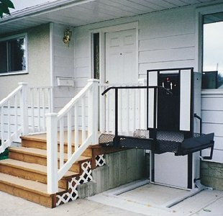
Things to consider
Ramps aren’t the only option
Consider a porch lift!
Can even climb up to a second story floor

Slide 24
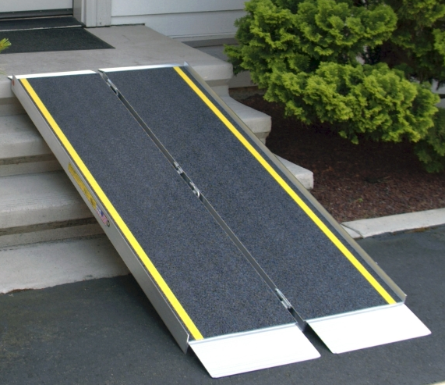
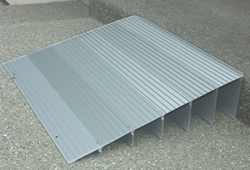
For here and there
Aluminum Ramps:
Threshold folding
Suitcase ramps

Slide 25
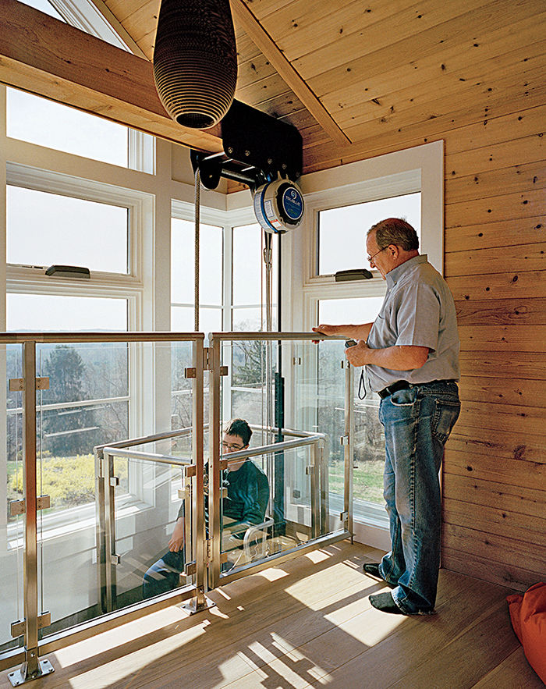
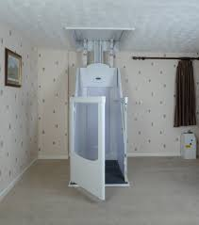
For two stories
Home Elevator or Lifts
Dolphin Lift through the ceiling

Slide 26
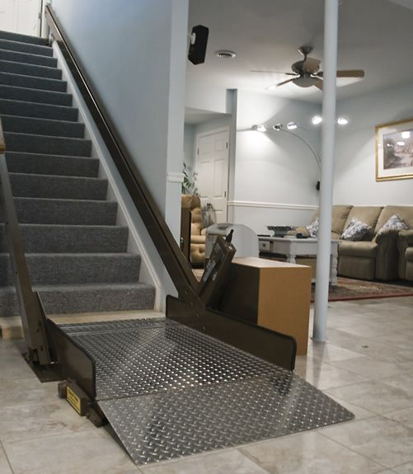
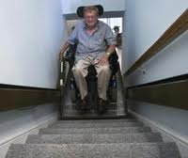
For two stories
Home Elevator or Lifts
Incline Platform lift

Slide 27
Living Areas
Next, see examples of:
Ramps
Living Areas
Bathrooms
Kitchens
Outdoor Living

Slide 28
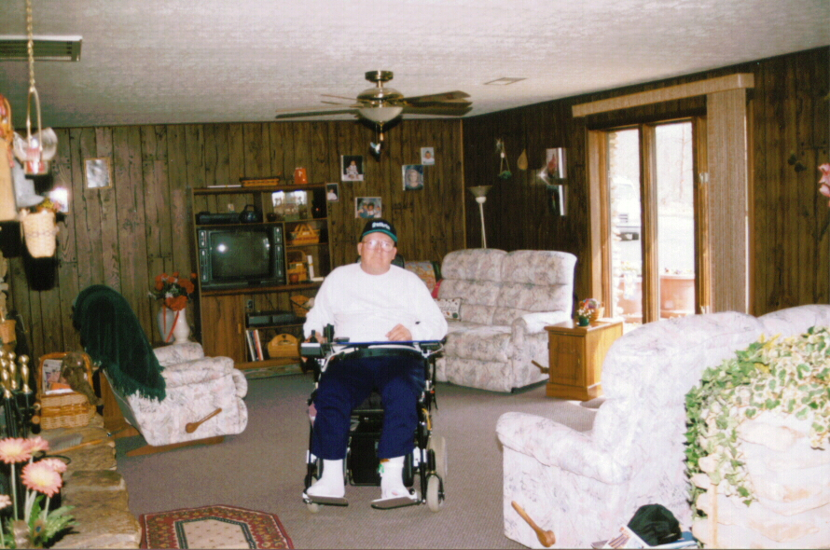
Living Areas
Get rid of area rugs and create an open floor plan!
Remove and store extra furniture!

Slide 29
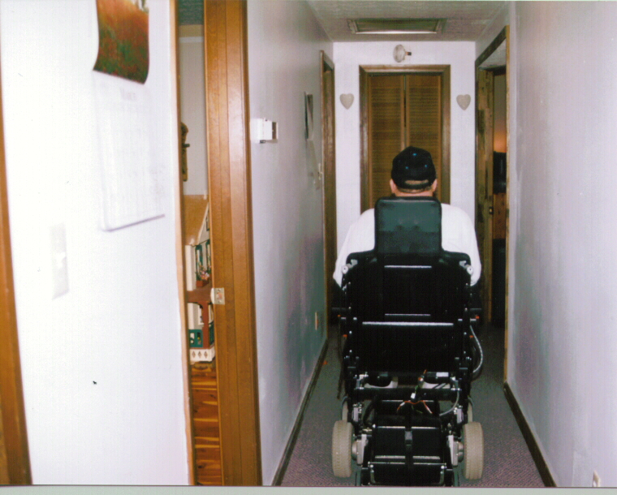
Living Areas
Know doorway widths and the width of your wheelchair
Most power chairs are 25” wide or less at powerbase
Choose a mid-wheel drive
Manual chairs are hip width + 4.5” on each side for wheels + push rims
Narrow hallways make it hard to complete turns into narrow doorways
Hallways 32” minimum

Slide 30
Living Areas
A 5’ wide hallway makes it possible to complete a 180° turn and makes turns into rooms off the hallway easier
Protective materials or panels can be added to protect the hallway drywall.
Add kick-plates for doors
Use swing clear door hinges

Slide 31
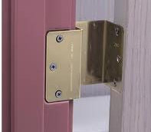
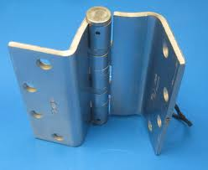
Living Areas
Swing Clear or Off-set door hinges take the thickness of the door out of the door width. This gives an extra 1-1.5” in the doorway.

Slide 32
Living Areas
Lever-style door knobs make managing doors much easier for everyone… but especially someone with poor hand strength
Push button door locks eliminate keys

Slide 33
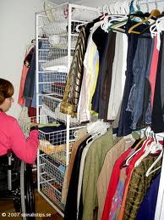
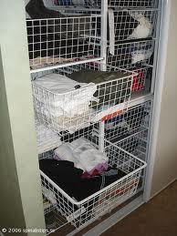
Living Areas
Adapting the Home: Living Areas
Closets:
Adding wire shelves & drawers to a closet creates functional reach at wheelchair level

Slide 34
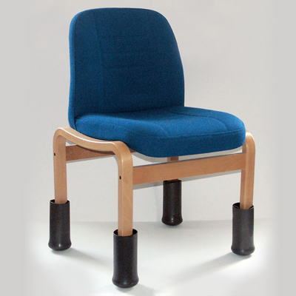
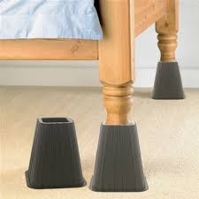
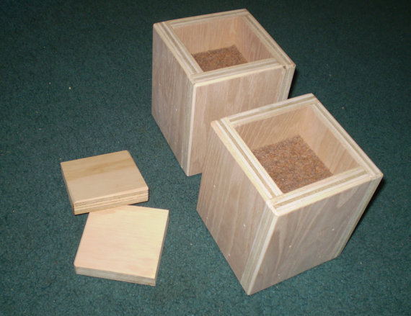
Living Areas
Adapting the Home: Living Areas
Adapting furniture
Make it a better height for transfers
Put risers on legs to increase the height of desks, beds, tables, couches & arm chairs!

Slide 35
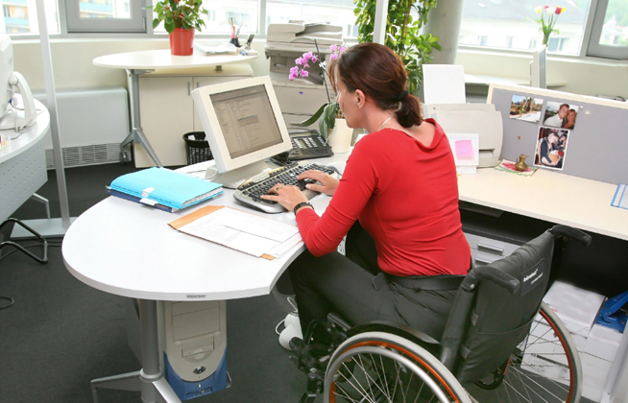
Living Areas
Adapting the Home: Living Areas
An efficient computer desk and workspace

Slide 36
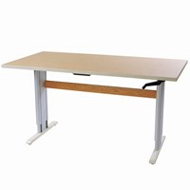
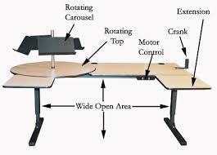
Living Areas
Adapting the Home: Living Areas
Choose a height adjustable computer desk and workspace… motorized or not!

Slide 37
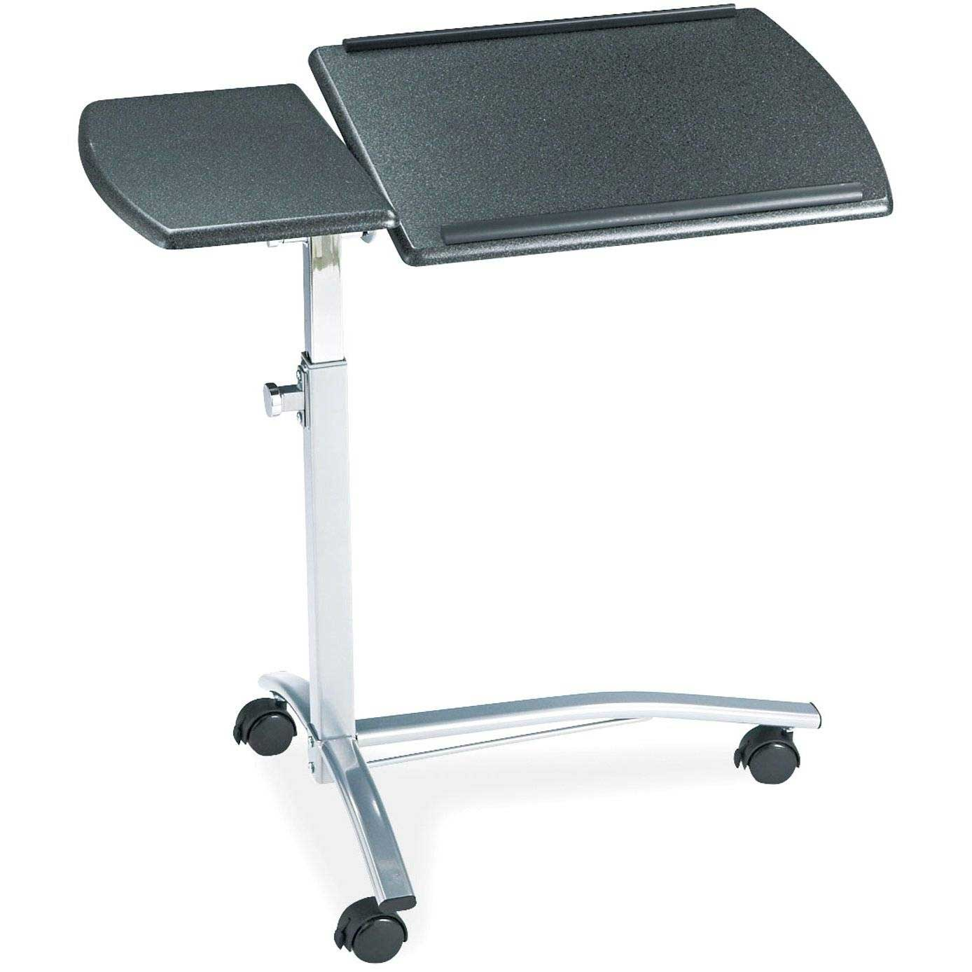
Living Areas
Adapting the Home: Living Areas
A Bean Bag desk or laptop desk can make any location into a work space.

Slide 38
Bathrooms
Next, see examples of:
Ramps
Living Area
Bathrooms
Kitchens
Outdoor Living

Slide 39
Bathrooms
Bathroom plans can vary greatly base on user needs
Lets look at simple ones first

Slide 40
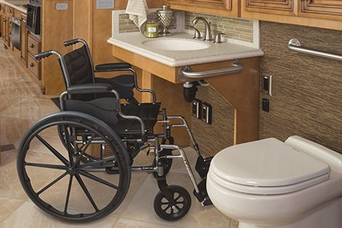
Bathrooms
Grab bars and transfer poles can be very important
Single lever faucets are helpful

Slide 41
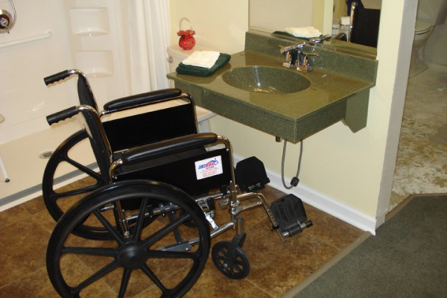
Bathrooms
An accessible powder room can make a home “visitable”

Slide 42
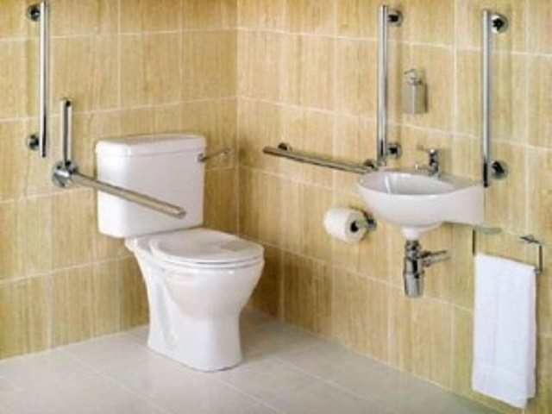
Bathrooms
There are many styles of grab bars & transfer aids

Slide 43
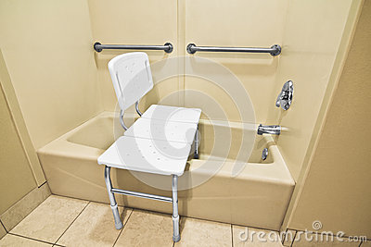
Bathrooms
Shower Bench Choices:
Padded or not
Inside the tub or straddling it
Adjustable leg length
Back support or not
Just add a handheld shower wand

Slide 44
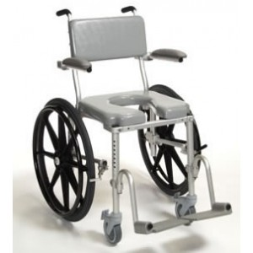
Bathrooms
Shower Chair
A person sitting in this chair can complete a bowel/bladder program taking advantage of the cut-out seat and then roll directly into a shower
Order tilt in space if needed

Slide 45
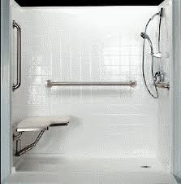
Bathrooms
Adapting the Home: Bathrooms
A drop-in fiberglass shower unit can fit into the floor space previously used by a bath tub

Slide 46
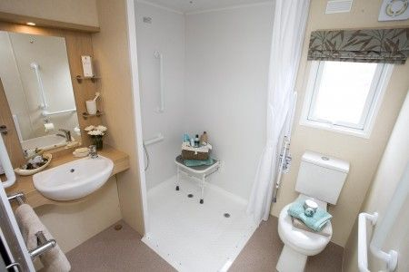
Bathrooms
Roll in Showers
Can even be created in mobile homes
Transfers happen outside the bathroom
Greatly reduced effort for caregiver

Slide 47
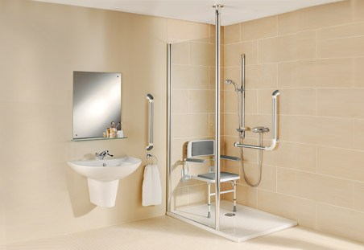
Bathrooms
Very functional
Open shelves are helpful for weak uppers
Shower head slides up & down
Lower the mirror

Slide 48
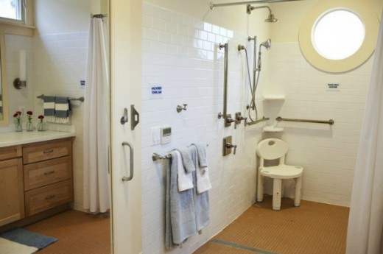
Bathrooms

Slide 49
Kitchen
Things to consider:
How much do you cook? Meals? Snacks? Reheat?
How far over the cabinet depth can you reach?
How high above your head can you reach?
How strong are your hands? Shoulders?
Do you have particular area of optimal function …like lap height? Or 6” lower than the counter top?
Let look at some ideas…

Slide 50
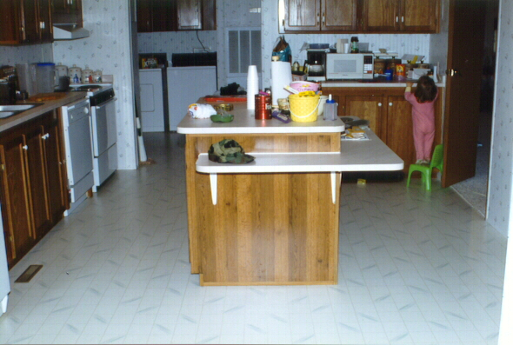
Kitchens
Adapting the Home: Kitchen
Adding a lap length shelf to an existing island can create a good work surface with room for knees
Moving a microwave to the countertop makes it easier to use

Slide 51
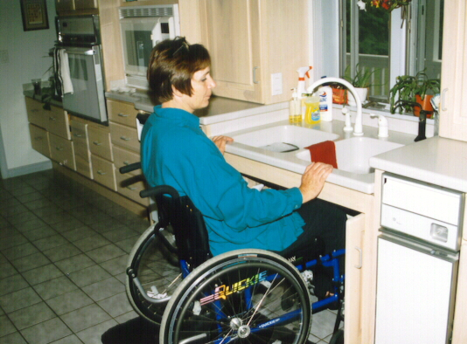
Kitchens
Adapting the Home: Kitchen
The kitchen sink may be a great place to start a kitchen re-do!
Lower only the sink
Buy a shallow sink
Install a lever faucet handle faucet
Roll the cabinet doors back inside the base unit

Slide 52
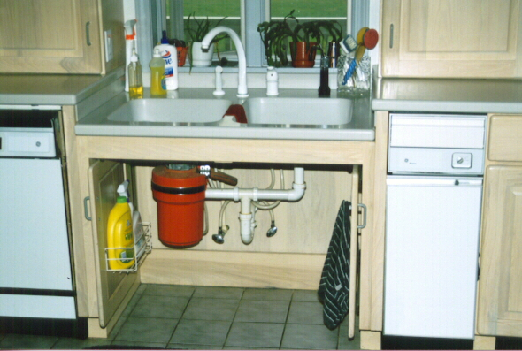
Kitchens
Adapting the Home: Kitchen
Remove the floor of the base cabinet
Doors roll back into the cabinet frame
Supplies hang on swing-out doors and make room for knees
Don’t forget…Pipes should be wrapped or insulated to prevent burns

Slide 53
Kitchens
A pull-out counter top is next to the wall oven
Note the dishes in slots

Slide 54
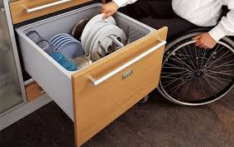
Kitchens
Food and dish storage in deep pull-out drawers

Slide 55
Kitchens
More ideas for storage

Slide 56
Kitchens
Floating cook top with knee space,
Can also be ordered with a motor to raise and lower the height
Also has a handy pull-out counter top or cutting board

Slide 57
Kitchens
Adapting the Home: Kitchen
Another approach…
Front controls on a non-gas stove are an important safety feature

Slide 58
Kitchens
A kitchen remodeled with IKEA components… Notice the open shelving for storage and ease of access

Slide 59
Kitchens
Totally remodel to make the perfectly accessible kitchen

Slide 60
Here and there
Laundry Room make over. What else would you change?

Slide 61
Here and there
Infant’s crib: Helpful when arms are weak. Changing table is adjacent.

Slide 62
Here and there
Pool & Hot Tub lifts

Slide 63
Here and there
Good news… the ADA requires that pools intended for pubic access must have a pool/hot tub lift!

Slide 64
Bring photos or floor plans of your house!
Planning for Discharge:
Use your phone or tablet to capture layout of your home or apartment

Slide 65
Get advice for your needs
Work with your OT and your family to get some specific advice based on your abilities, your home layout. At first, some changes will be more important than other changes

Slide 66
Resources
Most adaptations to the home can be done with minimal expense. Call on handy friends or church members.
Compare renovation cost against nursing home care or cost of hiring a homemaker or personal care assistant.
Your OT can advise on your level of ability and which modifications are most important for safety & function.
Don’t forget to use: YouTube, Google, Pinterist
Look for: Free floor plans for homes & home additions, products, ideas, etc.
Low interest loans from Tech Act Projects, Vocational Rehab, VA Healthcare, some Medicaid, etc.

